Slide 1

WAY TO ENTERPRISE
Java Basics
VTI ACADEMY
Author: duy.nguyenngoc1@vti.com.vn
March 2020

Slide 2
Agenda
OOP
Assignments
Copyright © VTI Academy All Rights Reserved

Slide 3
Abstraction (Continuing)
Abstract class
Interface

Slide 4
Interface
Is not object
Method of interface is public abstract method

Slide 5
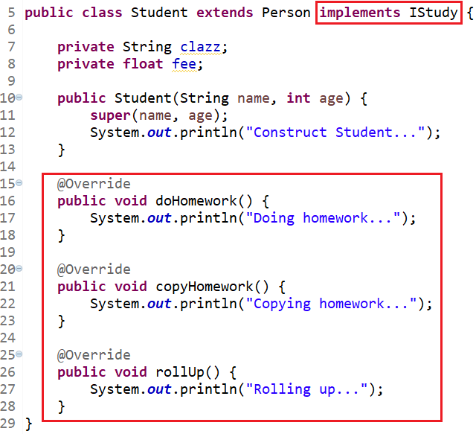
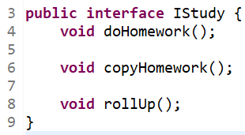
Example

Slide 6
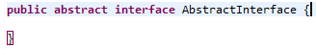
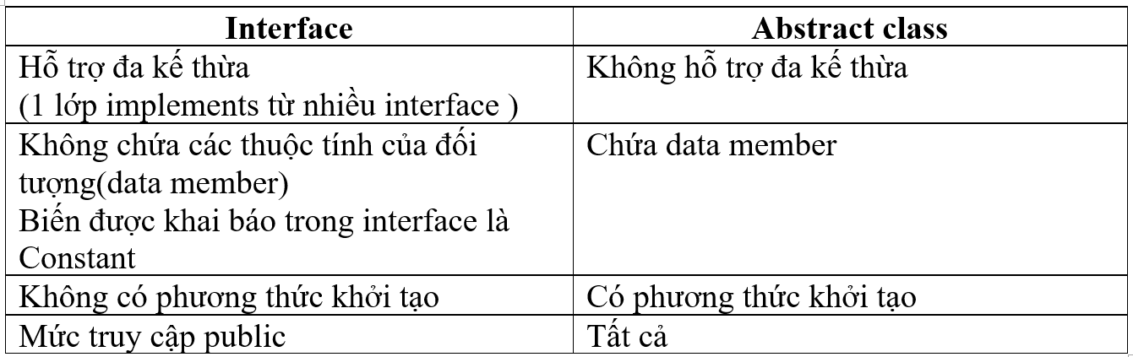
Abstract and interface
Variable in interface is constant
Method in interface is public abstract

Slide 7
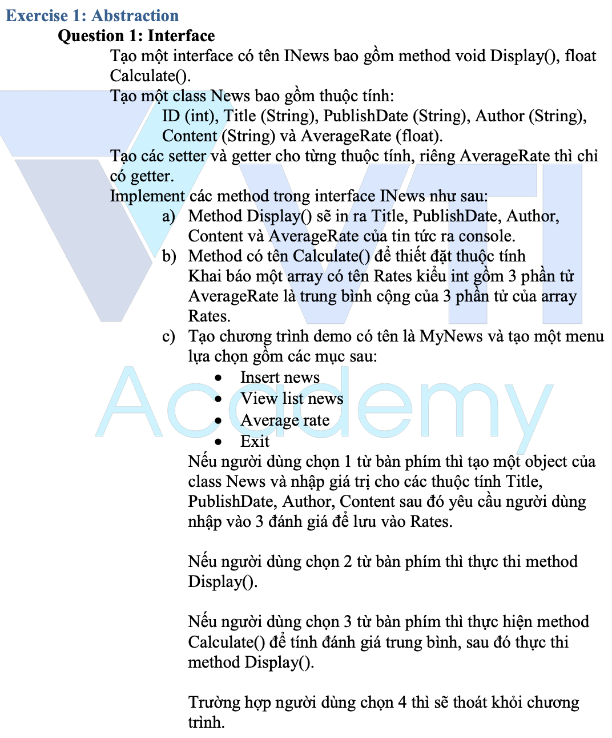
Testing System Assignments
Exercise 1: Abstraction

Slide 8
Polymorphism
Object Management (Manage Parent, Not manage child)
Keyword instanceof
Override và Overload

Slide 9
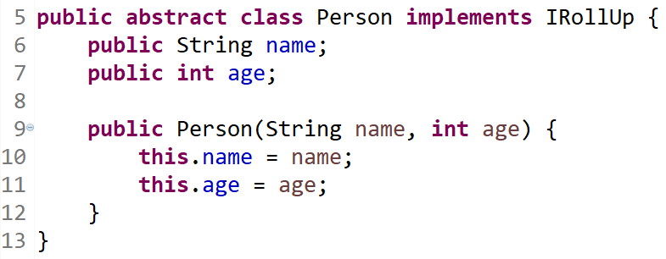
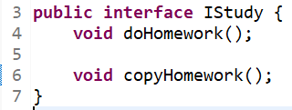
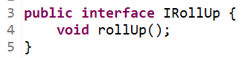
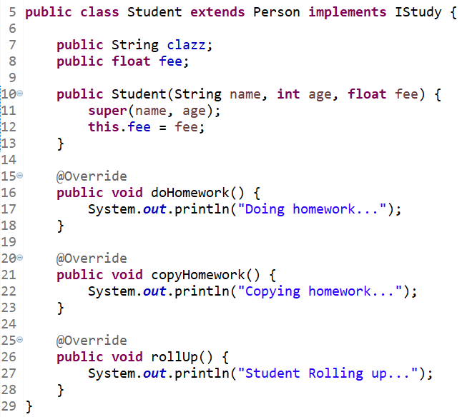
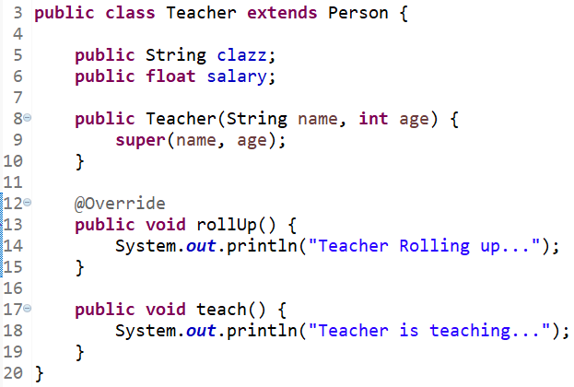
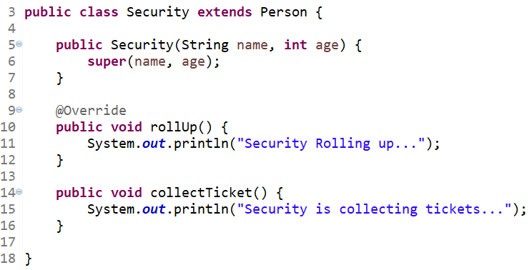
Object Management

Slide 10
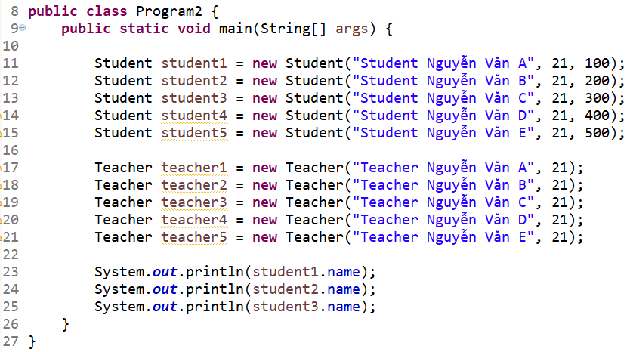
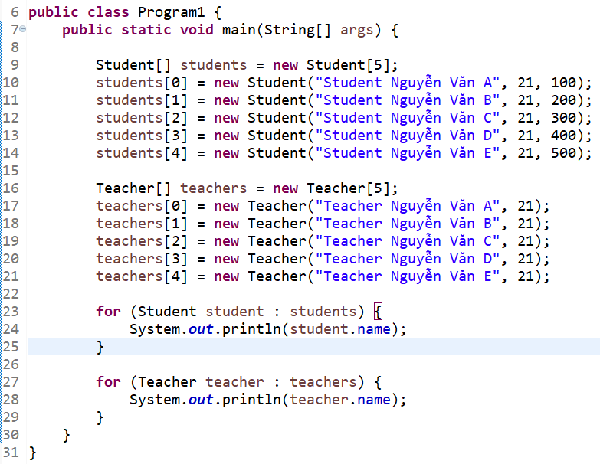
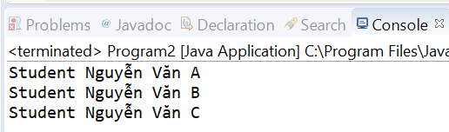
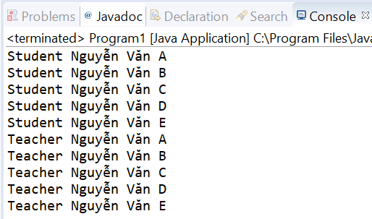
Object Management (Array)

Slide 11
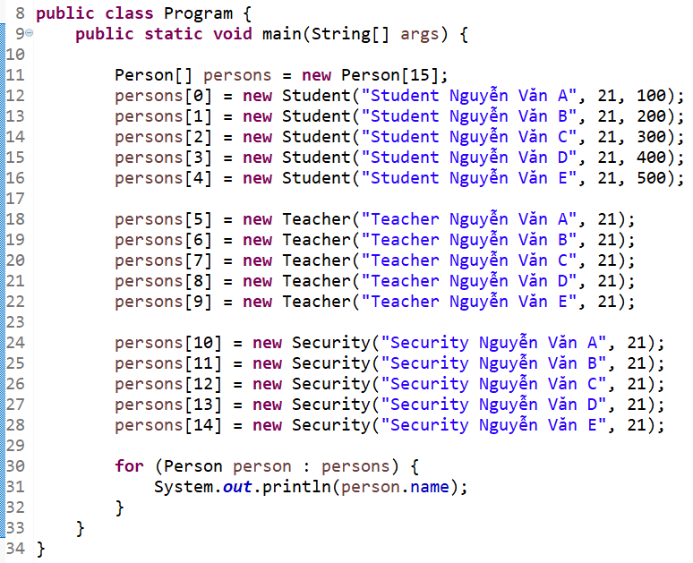
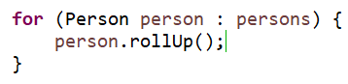
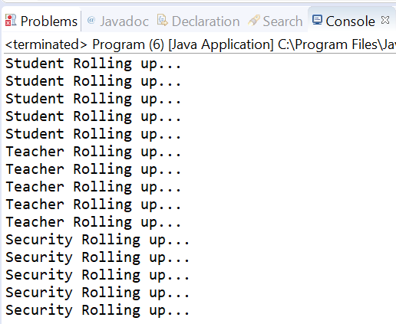
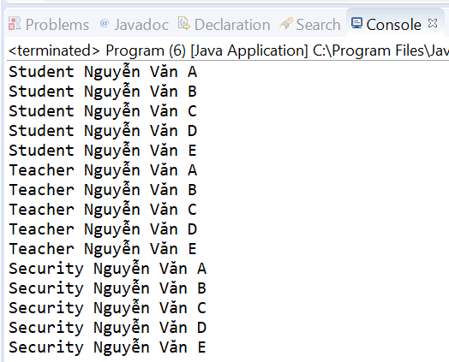
Object Management (Polymorphism- Common Property, method)

Slide 12
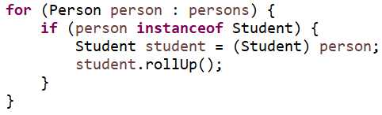
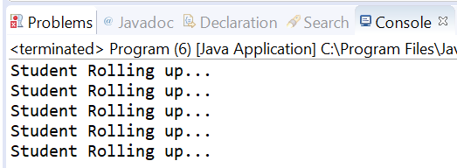
Object Management (Polymorphism- Child’s Property, method)

Slide 13
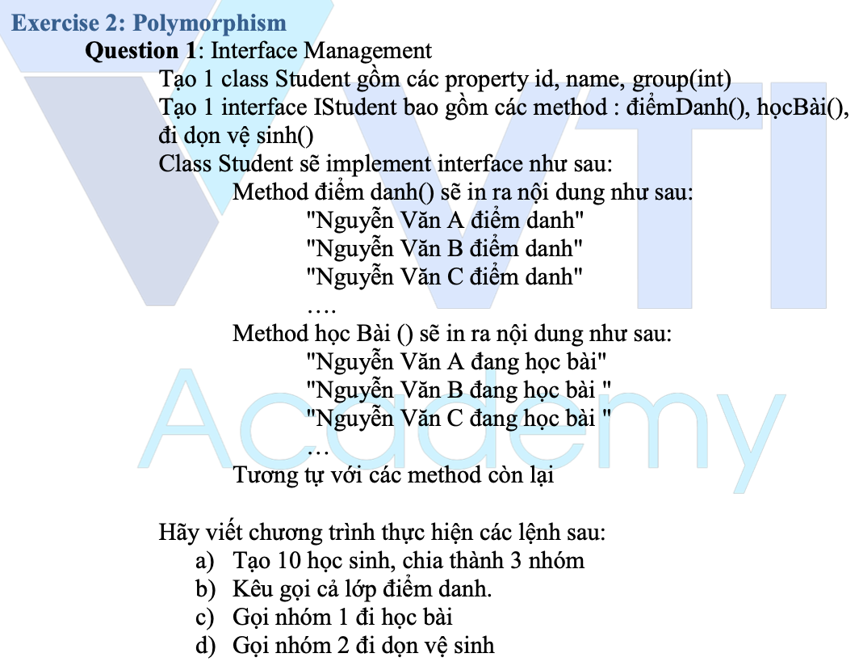
Testing System Assignments
Exercise 2: Polymorphism - Question 1: Interface Management

Slide 14
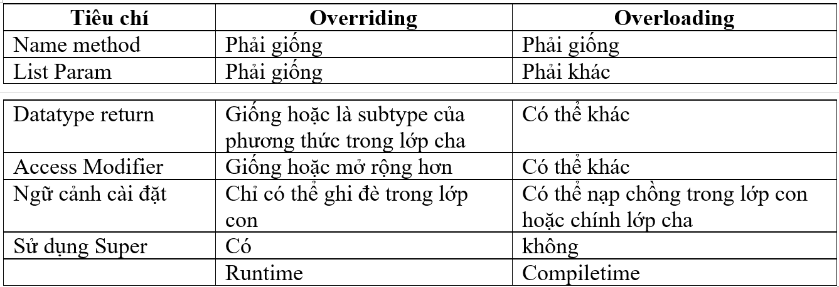
Override and Overload

Slide 15
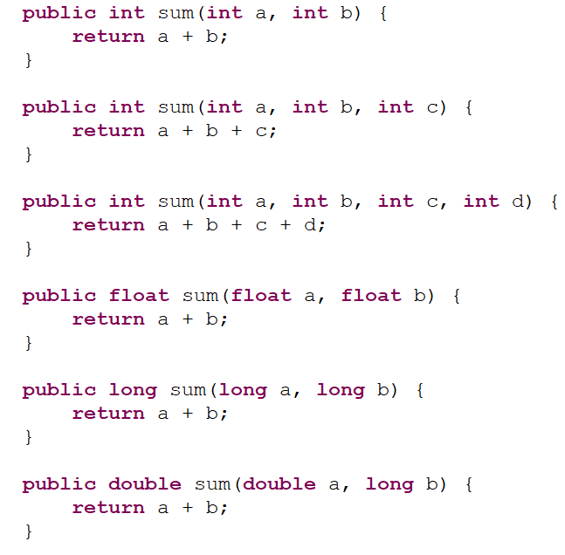
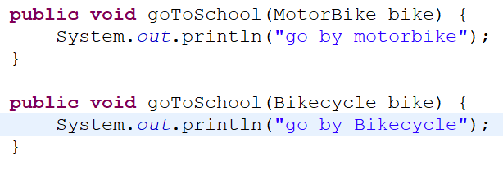
Overloading Example

Slide 16
Testing System Assignments
Exercise 2: Polymorphism - Question 2: Abstract management

Slide 17
This & super

Slide 18
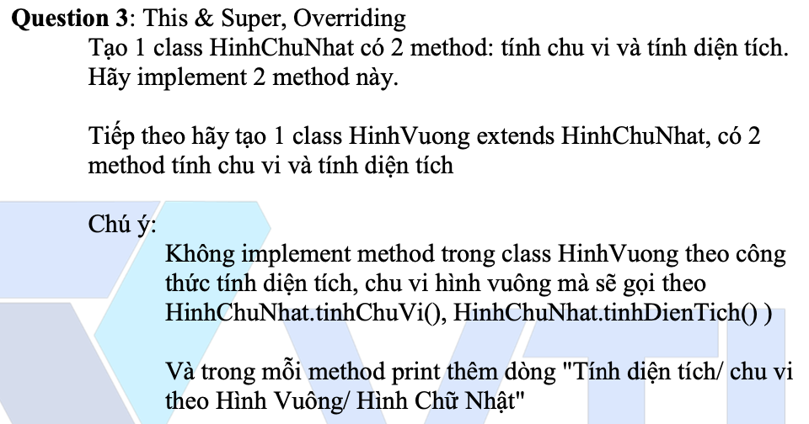
Testing System Assignments
Exercise 2: Polymorphism - Question 3: This & Super, Overriding

Slide 19
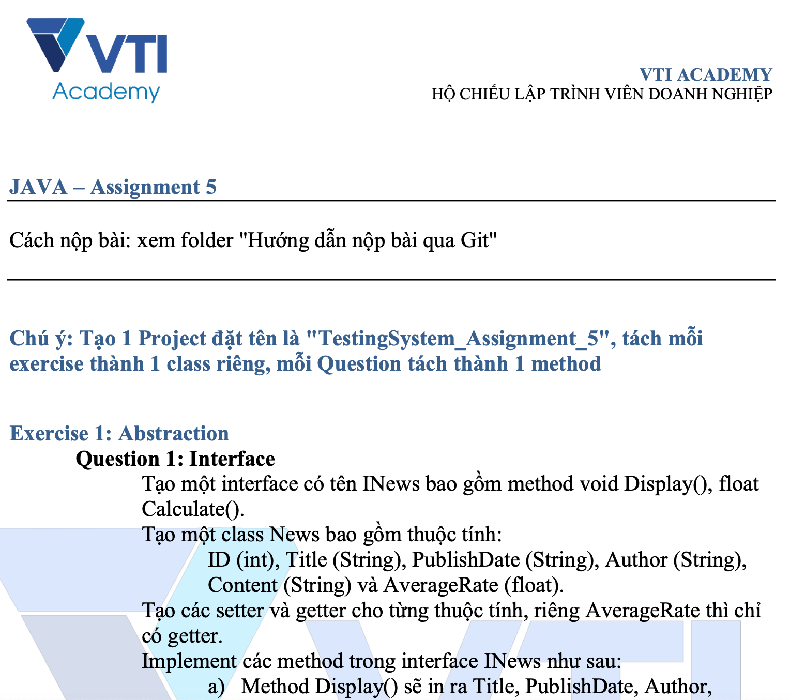
Testing System Assignments

Slide 20
Q & A
Copyright © VTI Academy All Rights Reserved

